Slide 1
SCREENING OF DYSGRAPHIA IN PREADOLOSCENT CHILDREN USING MACHINE LEARNING
- Paper ID: 310
-Authors
Ch. Mandakini - Assistant Professor
Dr. M. Seetha - Professor
G. Prathyusha - B.Tech Student
G. Charishma - B.Tech Student
G. TharunyaVarma - B.Tech Student
V. Rakshitha - B.Tech Student
-Presenting Author
G. Prathyusha
- B.Tech Student

Slide 2
Agenda
Introduction
Literature Survey
Existing system
Proposed System
Objectives
Methodology
Modules
Implementation of modules
Results
Conclusions

Slide 3
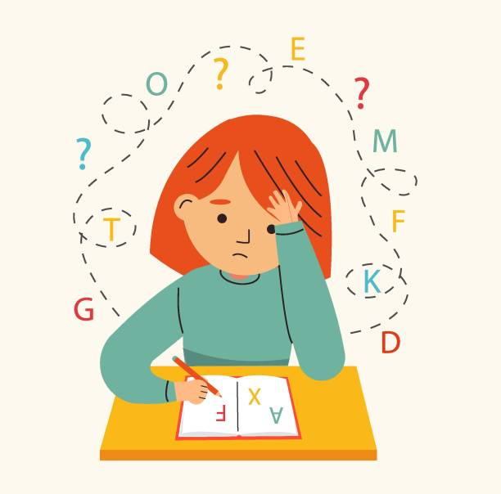
Introduction --What is DYSGRAPHIA??
Dysgraphia is a learning difficulty that affects a person's ability to write.
It is a neurological condition that can impact a person's handwriting, spelling, and ability to put their thoughts on paper and may struggle with organizing their thoughts.
If it can be identified at an early stage, parents and teachers will be able to identify the problem with the child.
The automation can help in recognizing writing by parents and teachers without the help of clinical psychologists.

Slide 4
Characteristics of abnormal handwriting
Poor Handwriting
Slow writing speed
Poor motor skills
Difficulty with spelling and Trouble with grammar.
Inconsistent Spacing
Difficulty with organizing thoughts

Slide 5
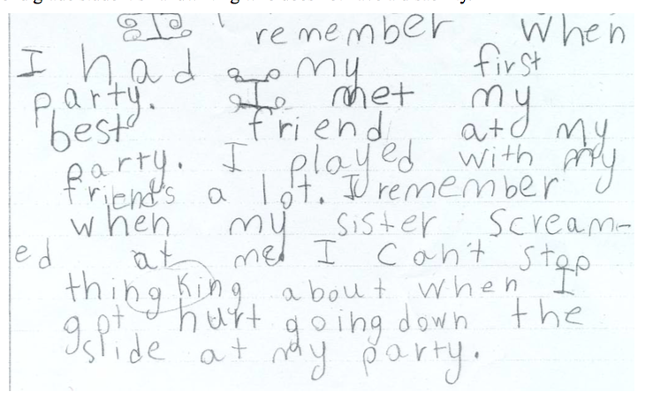
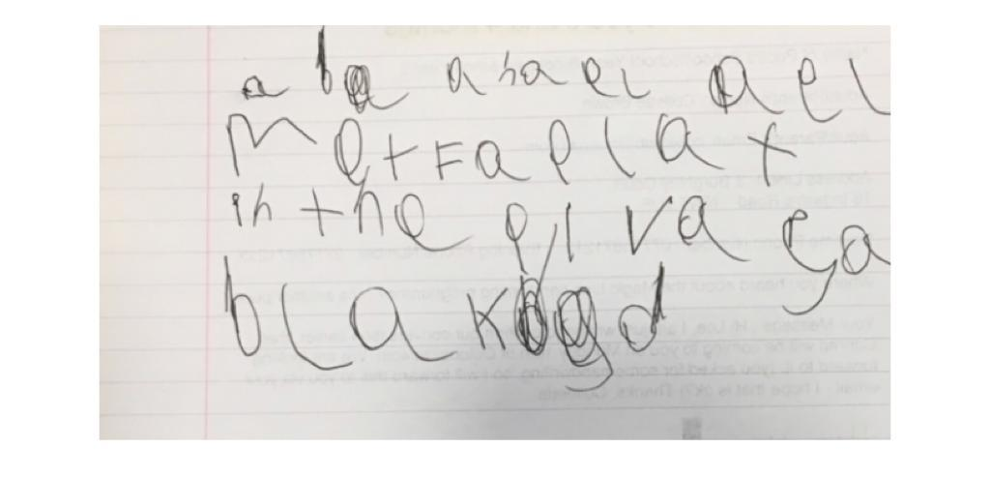
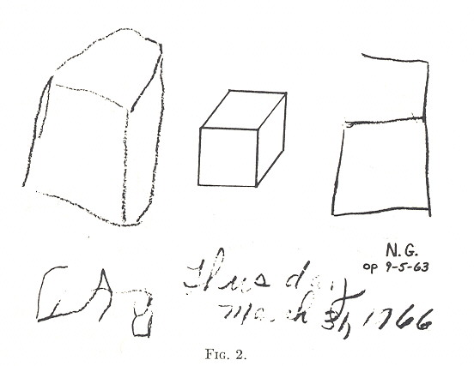

Handwriting Samples to show signs of Dysgraphia

Slide 6
Literature Survey
Title of the paper | Technology/ Algorithms Used | Work Done | Limitations
Identification and characterization of learning weakness from drawing analysis at the pre-literacy stage By Linda Greta Dui,Eugenio Lomurno , Cristiano Termine(2022) | Deep learning Models | Comparing several ML algorithms discovered that the best results were achieved by the adaptive boosting algorithm with 80% accuracy. | Focused solely on analyzing children’s drawings,which may not provide a comprehensive picture of their learning weakness.
Acquisition of handwriting in children with and without dysgraphia: A Computational approach by Gargot T,Asselborn T, Pellerin (2020) | Clinical gold standard methods ,Statistical models ,K-means clustering algorithm,elbow method | Identified the best Features ,to diagnose the children with Dysgraphia using BHK,BHK for teenagers, DASH and many other tests. | No balance between positive and negative samples.
Automated human level diagnosis of dysgraphia using a consumer tablet by Thibault Asselborn,Thomas Gargot , Wafa Johal (2018) | Ajuriaguerra, BHK tests. Random Forest Algorithm . | Digitalized tablets are used to collect handwriting samples and With the help of Gini importance, 8 most important features seemed to be most important | Used very Limited sample size
Dysgraphia detection through Machine Learning by Peter Drotar and Marek Dobes (2020) | Convolutional Neural Networks (CNN), SVM | Speed, accuracy, quality of their writing features drawn, play write draw app is used | Could not pin point differences between children of different ages

Slide 7
EXISTING SYSTEM
Parent and teacher questionnaires: Parent and teacher questionnaires are often used to identify signs of dysgraphia in children. These questionnaires may ask about a child's writing abilities, fine motor skills.
2. Consulting Clinical Psychologists: Psychologists with the help of clinical tests identify whether the child is dysgraphic or non- dysgraphic.
3. There are some Machine learning models to detect dysgraphia but those ML models considered the age groups of 7 to 15. During this period there will be drastic change in the development of handwriting, which may not give accurate results.
4. Level of severity of dysgraphia is not concentrated.

Slide 8
PROPOSED SYSTEM
Collecting the Handwriting samples from preadolescents using Graphical tablets.
Extracting the features of Hand writing using Graphical tablets integrating with Movalyzer Software.
Using Machine Learning algorithms to analyze large amounts of data by collecting handwriting samples to predict the likelihood of dysgraphia.

Slide 9
Advantages of Proposed System
1.Early detection: Early detection of dysgraphia is essential to ensure that the individual receives appropriate support and accommodations to succeed in school and beyond the proposed system includes assessments and technology- based tools that can help detect dysgraphia early on.
2. Individualized support: The individualized support can help the person overcome the challenges of dysgraphia and succeed in academic and social contexts.

Slide 10
Objectives
To collect the handwriting samples from abnormal and normal preadolescents using graphical tablet.
To extract and analyze significant features from movalyzer software.
To develop a model that can detect dysgraphia in children through handwriting analysis using machine learning techniques.
To evaluate the performance of the model using suitable metrics classifying dysgraphic and non dysgraphic.

Slide 11
Methodology
Handwriting Dataset
Data preprocessing
Feature Extraction
Prediction Model
Data preprocessing
Test Sample
Writing Disability
Normal

Slide 12
Data Collection
S.NO | Standard | No.of Participants | DYSGRAPHIC | NON-DYSGRAPHIC
1 | 3rd | 27 | 9 | 18
2 | 4th | 37 | 4 | 33
3 | 5th | 18 | 0 | 18
4 | Total | 82 | 13 | 69
Data is collected from children of 2 different schools Jamilapet and Kondamadugu government schools from different age groups 7 to 8 , 9 to 10 and 10 to 12 by using graphical tablet.

Slide 13
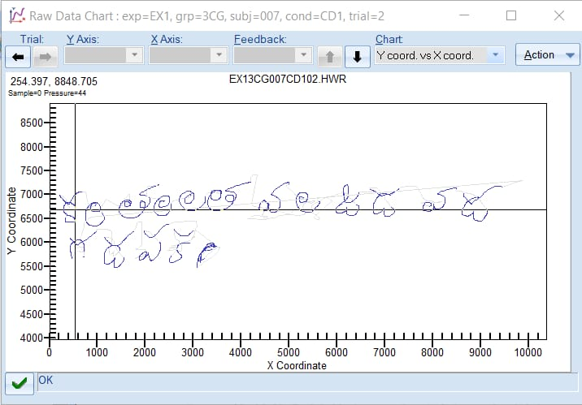
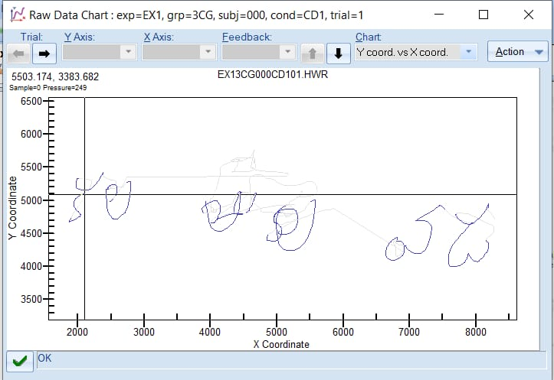
Results of Data Collection

Slide 14
Preprocessing
Preprocessing includes equal frequency discretization technique for converting time series data to discrete data.
Equal frequency discretization divides the data into intervals with an equal number of observations, which can be useful when the data is skewed or has outliers.
The technique ensures that each bin contains approximately the same number of observations, which can help to minimize the impact of outliers or unusual data points.

Slide 15
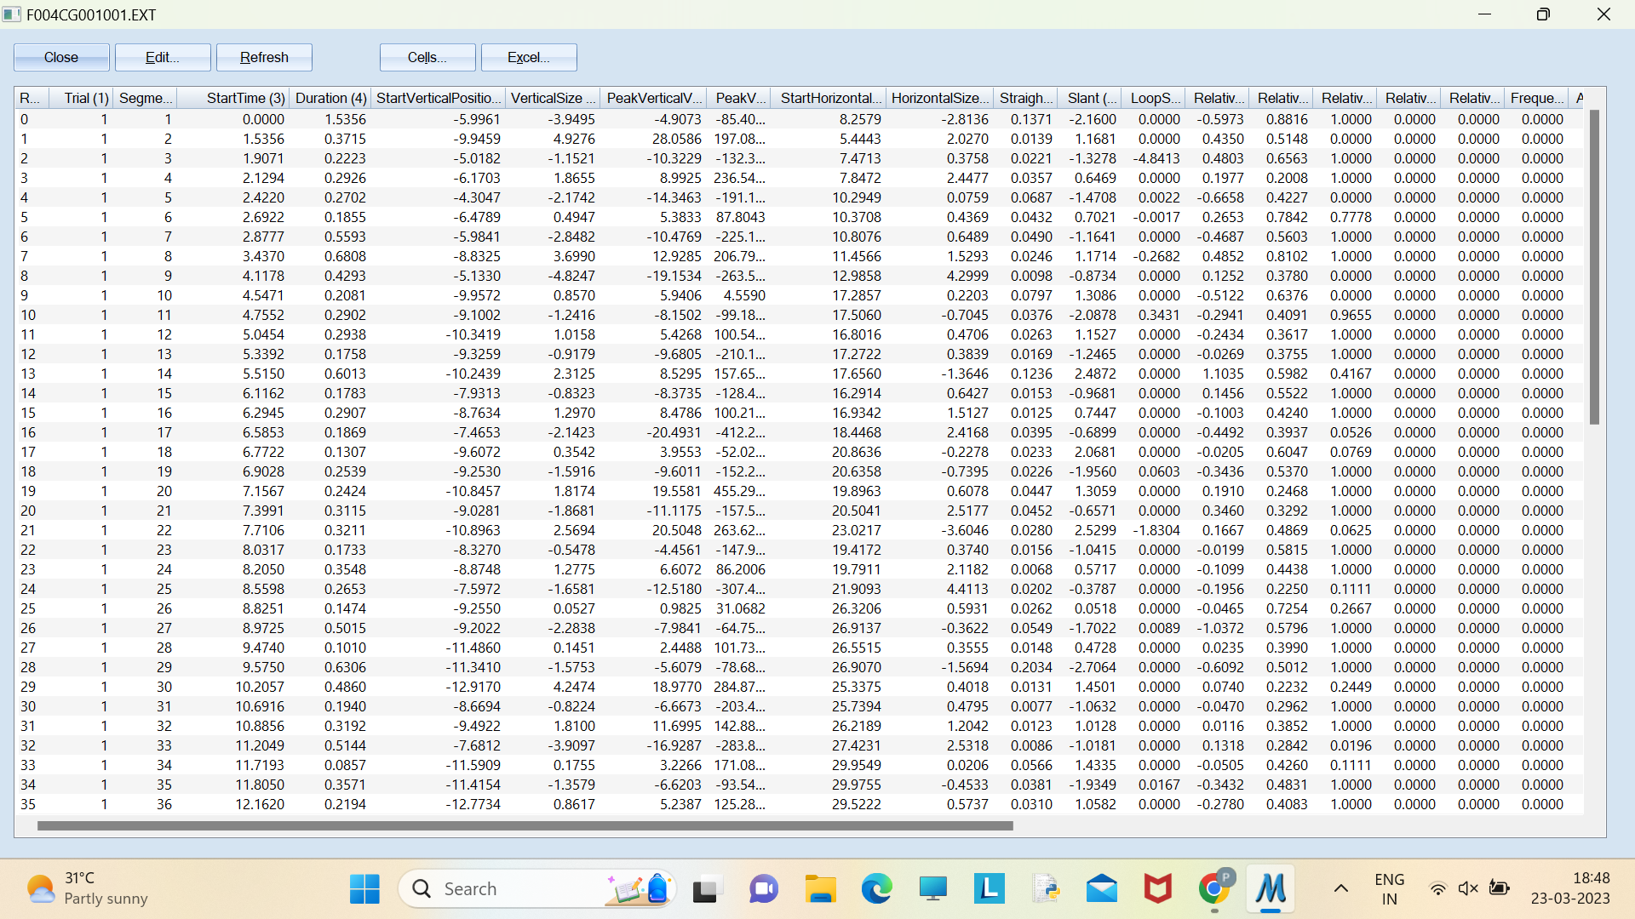
Extracted Data – Before Data Preprocessing

Slide 16
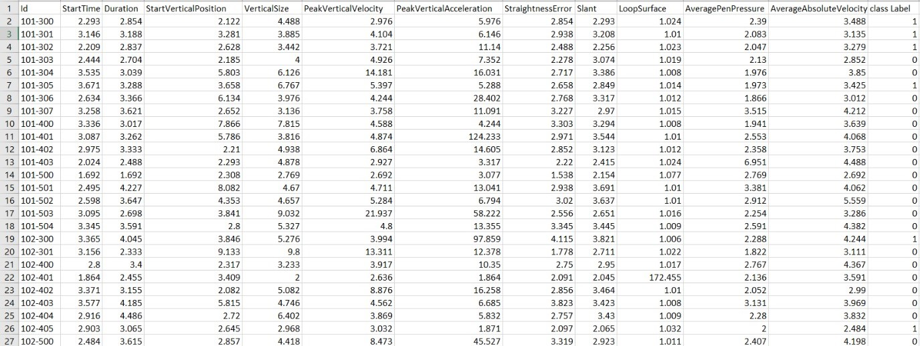
Pre processed Data

Slide 17
Features extracted by Movalyzer
Start Time
Duration
Start Vertical Position
Vertical Size
Peak Vertical Velocity
Peak Vertical Acceleration
Start Horizontal Position
Horizontal Size
Straightness Error
Slant
Loop Surface
Relative Initial Slant
Relative Time To Peak Vertical Velocity
Relative Pen Down Duration
Relative Duration of Primary
Relative Size of Primary
Frequency of Secondary
Absolute Size
Average Absolute Velocity
Road length
Absolute y Jerk
Normalized y Jerk
Average Normalized y Jerk Per Trial
Absolute Jerk
Normalized Jerk
Average Normalized Jerk Per Trial
Score
Number Of Peak Acceleration Points
Average Pen Pressure
Trial Seq
Num Of Strokes

Slide 18
Feature Extraction
The features are extracted with the help of graphical tablet using movalyzer software.
The handwriting task will generate several raw data values (x position, 𝑦 position, time, pen position indicator) for each participant. The features are extracted from the combined handwritten content for each individual.
Out of all the features extracted by the movalyzer software, static ,kinematic ,pressure and tilt features are considered as important features.11 significant features are extracted.

Slide 19
Feature Selection
11 features:
Start Time
Duration
Start Vertical Position
Vertical Size
Peak Vertical Velocity
Peak Vertical Acceleration
Straightness Error
Slant
Loop Surface
Average pen Pressure
Average Absolute Velocity

Slide 20
Model Training
Different train-test split ratios 60-40,70-30,80-20 are considered for training the model.
Model Training is done using discriminative properties associated with dysgraphia.Common classifiers such as Decision tree, Logistic regression, LDA, QDA, KNN, Random forests and Adaptive boosting.
Evaluation metrics such as accuracy, precision, recall, and F1-score are used to assess the classifier's performance, ensuring its effectiveness in accurately classification.

Slide 21
Data Sample | Algorithm | Train-Test split ratio | Accuracy | Precision | Recall | F1Score | Support | ROC curve Area
69-NonDysgraphic 13-Dysgraphic | Decision Tree Classifier | 60-40 | 75.76% | 0.72 | 0.76 | 0.74 | 33 | 0.53
 |  | 70-30 | 76% | 0.72 | 0.76 | 0.74 | 25 | 0.55
 |  | 80-20 | 64.71% | 0.42 | 0.65 | 0.51 | 17 | 0.50
 | Random Forest Classifier | 60-40 | 75.76% | 0.57 | 0.76 | 0.65 | 33 | 0.64
 |  | 70-30 | 80% | 0.64 | 0.80 | 0.71 | 25 | 0.63
 |  | 80-20 | 76.47% | 0.58 | 0.76 | 0.66 | 17 | 0.87
 | Naive bayes Classifier | 60-40 | 72.72% | 0.68 | 0.73 | 0.70 | 33 | 0.48
 |  | 70-30 | 76% | 0.63 | 0.76 | 0.69 | 25 | 0.78
 |  | 80-20 | 70.59% | 0.50 | 0.71 | 0.58 | 17 | 0.70
 | Linear Discriminant Analysis | 60-40 | 69.70% | 0.75 | 0.70 | 0.72 | 33 | 0.54
 |  | 70-30 | 72% | 0.63 | 0.72 | 0.67 | 25 | 0.62
 |  | 80-20 | 64.70% | 0.42 | 0.65 | 0.51 | 17 | 0.78
 | Quadratic Discriminant Analysis | 60-40 | 78.79% | 0.62 | 0.79 | 0.69 | 33 | 0.50
 |  | 70-30 | 80% | 0.64 | 0.80 | 0.71 | 25 | 0.50
 |  | 80-20 | 76.47% | 0.58 | 0.76 | 0.66 | 17 | 0.50
 | Logistic Regression | 60-40 | 72.73 % | 0.65 | 0.73 | 0.69 | 33 | 0.66
 |  | 70-30 | 76% | 0.63 | 0.76 | 0.69 | 25 | 0.74
 |  | 80-20 | 58.82% | 0.40 | 0.59 | 0.48 | 17 | 0.82
 | Gradient Boosting Classifier | 60-40 | 66.67% | 0.60 | 0.67 | 0.63 | 33 | 0.42
 |  | 70-30 | 80% | 0.64 | 0.80 | 0.71 | 25 | 0.42
 |  | 80-20 | 70.59% | 0.50 | 0.71 | 0.58 | 17 | 0.50
 | XG Boost Classifier | 60-40 | 78.79% | 0.76 | 0.79 | 0.77 | 33 | 0.41
 |  | 70-30 | 76% | 0.63 | 0.76 | 0.69 | 25 | 0.53
 |  | 80-20 | 70.59% | 0.57 | 0.71 | 0.63 | 17 | 0.67
 | AdaBoost Classifier | 60-40 | 69.70% | 0.80 | 0.70 | 0.75 | 33 | 0.38
 |  | 70-30 | 64% | 0.61 | 0.64 | 0.62 | 25 | 0.40
 |  | 80-20 | 70.59% | 0.76 | 0.71 | 0.73 | 17 | 0.40
The 70-30 split was identified as the optimal reference ratio for subsequent processing due to its better performance for most of the algorithms.

Slide 22
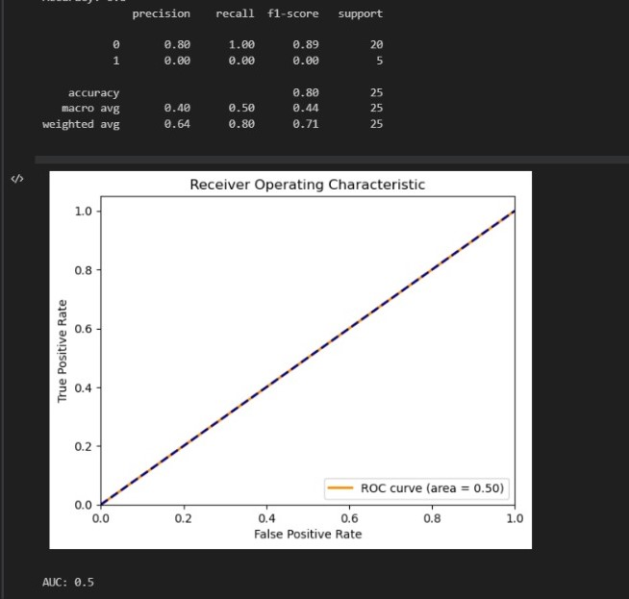
Random Forest and QDA has shown better accuracy 80% with ROC curve area as 0.5.

Slide 23
Data Augmentation
To balance the dataset in-terms of positive and negative samples, data augmentation techniques are applied which leverages by generating additional synthetic data, the model can learn from a larger and more diverse dataset, improving its ability to accurately classify dysgraphic and normal.
Borderline SMOTE -Borderline SMOTE first identifies the borderline samples and then applies the SMOTE technique to these samples only.
Random over sample - only a random subset of the minority class samples is used for synthetic sample generation.

Slide 24
Data Sample | Algorithm | BorderLine Smote | Random Smote
69-NonDysgraphic 69-Dysgraphic | Decision Tree Classifier | 76.19% | 90.48%
 | Random Forest Classifier | 83.33% | 90.48%
 | Naive bayes Classifier | 80.95% | 78.57%
 | Linear Discriminant Analysis | 83.33% | 73.80%
 | Quadratic Discriminant Analysis | 90.47% | 83.33%
 | Logistic Regression | 83.33% | 78.57%
 | K-Nearest Neighbor (Manhattan distance) | 73.81% | 76.19%
 | Gradient Boosting Classifier | 88.09% | 90.47%
 | XG Boost Classifier | 88.09% | 92.85%
 | AdaBoost Classifier | 83.33% | 95.23%
By combining the power of supervised machine learning algorithms, data augmentation techniques, and optimized training-testing splits, the developed system achieves highest accuracy 95.23% for AdaBoost Classifier to detect dysgraphia in children's data.

Slide 25
Data Augmentation after applying Accuracy-Hyperparameter Tuning using Grid Search with cross-validation
When combined with Accuracy-Hyperparameter Tuning using Grid Search with cross-validation, the model's performance can be thoroughly evaluated across different hyperparameter combinations.
The iterative process allows for the discovery of the best hyperparameter configuration, leading to a model that is optimized for the specific task and dataset, ultimately increasing accuracy.

Slide 26
Data Sample | Algorithm | BorderLine Smote | Random Smote
69-NonDysgraphic 69-Dysgraphic | Decision Tree Classifier | 78.57% | 95.24%
 | Random Forest Classifier | 90.48% | 92.86%
 | Naive bayes Classifier | 83.33% | 78.57%
 | Linear Discriminant Analysis | 88.09% | 83.33%
 | Quadratic Discriminant Analysis | 95.24% | 88.09%
 | Logistic Regression | 85.71% | 80.95%
 | K-Nearest Neighbor (Manhattan distance) | 76.19% | 80.95%
 | Gradient Boosting Classifier | 92.86% | 95.23%
 | XG Boost Classifier | 90.47% | 95.23%
 | AdaBoost Classifier | 90.48% | 97.61%
By applying grid-search with cross validation, the developed system achieves highest accuracy 97.61% for AdaBoost Classifier to detect dysgraphia in children's data.

Slide 27
Results
Handwriting samples are collected using graphical tablets that can provide insight into a person’s writing abilities.
Raw data is processed and features are extracted using movalyzer software.
Features are reduced by analyzing and understanding the significance of each of them in detecting dysgraphia.
Machine learning techniques are applied to extract and analyze handwriting features, classify normal and abnormal handwriting.

Slide 28
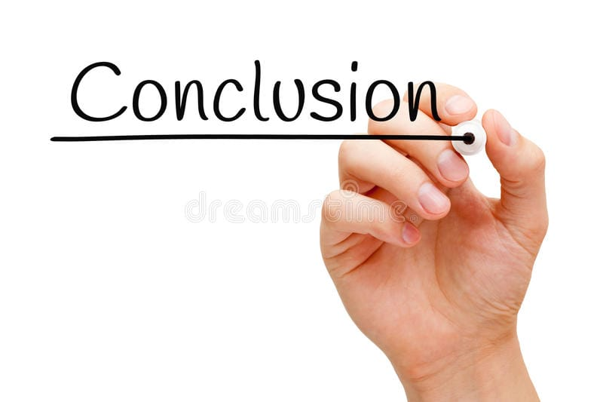
.
By supervised machine learning algorithms, data augmentation techniques, and optimized training-testing splits, the developed system achieves highest accuracy 97.61% for AdaBoost Classifier to detect dysgraphia in children's data.
In conclusion, the development of a dysgraphia detection system is a significant step towards early diagnosis and intervention for individuals with writing difficulties.

Slide 29
References
[1] Abhishek B Kacher, Abhinav Manikanta, Adith Shivakumar, Chandan R, “Early Detection of Dysgraphia using Convolutional Neural Networks”, May 2022.
[2] Devillaine, L Lambert, R Boutet, Aloui, S, Brault, V,Jolly, C, Labyt, E. “ Analysis of Graphomotor Tests with Machine Learning Algorithms for an Early and Universal Pre-Diagnosis of Dysgraphia”, Sensors 2021.

Slide 30
THANK YOU - G.Prathyusha

